Slide 1

The Economic and Social Contribution of the University of Connecticut
(FY 2012–13)
September 2014

Slide 2
About Tripp Umbach
Tripp Umbach has experience throughout North America in completing economic impact studies for major research universities, hospitals, corporations, and research partnerships such as:
  Indiana University
  The Ohio State University
  The Pennsylvania State University
  University of Arizona
  The University of Iowa
  University of Minnesota
  University of Michigan
  University of Pittsburgh
  University of Washington

Slide 3
About Tripp Umbach
Tripp Umbach has made numerous presentations on the topic of economic impact of universities and hospitals at state and national conferences.
Since 1995, Tripp Umbach has completed national studies of the economic impact of all 130 medical schools and 400 teaching hospitals for the Association of American Medical Colleges (AAMC).

Slide 4
UConn Study Goals
Quantitative measure of net economic expansion to the economy;
Direct and indirect jobs supported as a result of the University’s spending;
Attraction of out-of-state visitors and out-of-state patients;
Direct and indirect local and state tax revenue generated by the University;
Quantification of annual charitable donations, volunteerism, and community leadership; and
Economic impact of UConn alumni and graduates.
Notes:
UConn’s Annual Impact on the Connecticut Economy is $3.4 billion in total economic impact generated by UConn. There are 24,235 jobs supported and sustained throughout the state or one in 90 jobs is attributable to UConn. $202.5 million in tax revenue to state and local governments, including sales, property and business tax payments.

Slide 5
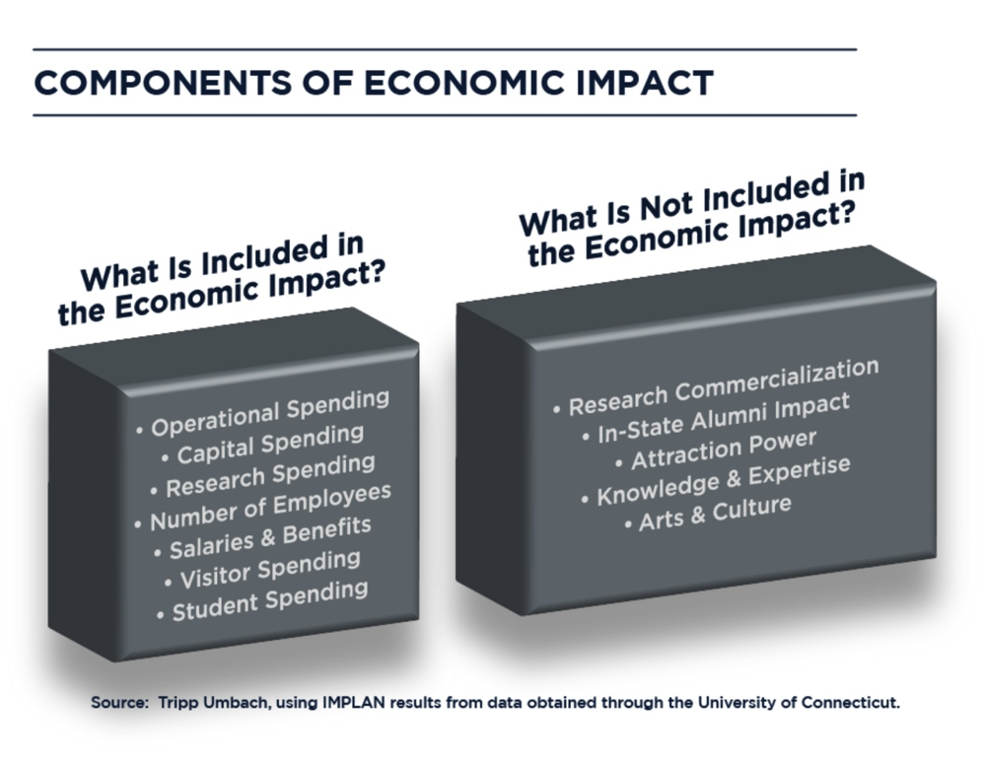
Methodology & Analysis
The economic impact study was conducted using IMPLAN (input-output analysis). Primary data utilized to conduct the analysis was collected from UConn.
Data included: capital expenditures, operational expenditures, jobs, payroll & benefits and taxes.
The approach taken on this study was decidedly conservative.
5
Notes:
UConn’s Annual Impact on the Connecticut Economy is $3.4 billion in total economic impact generated by UConn. There are 24,235 jobs supported and sustained throughout the state or one in 90 jobs is attributable to UConn. $202.5 million in tax revenue to state and local governments, including sales, property and business tax payments.

Slide 6
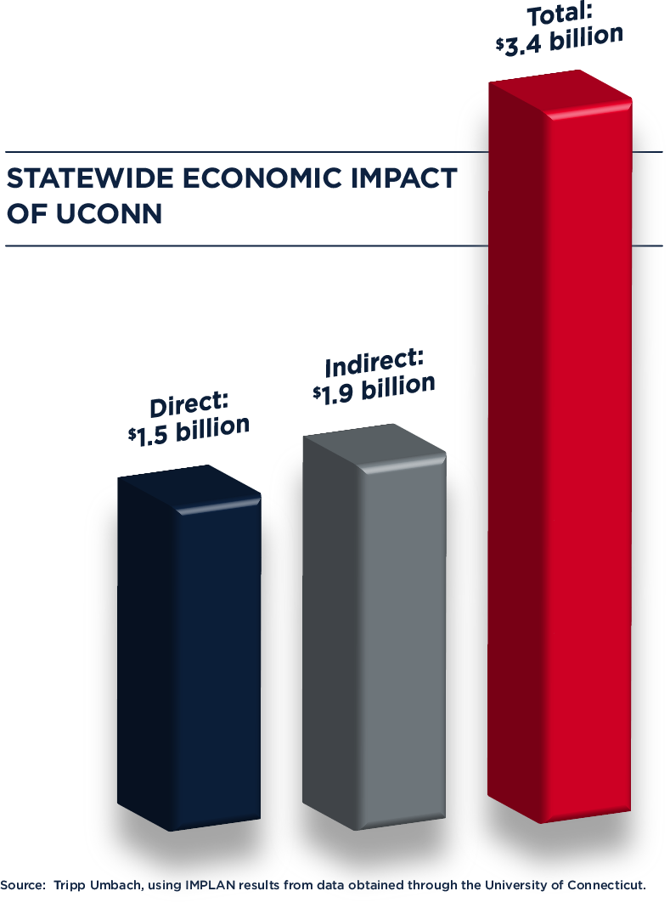
Impacting the Connecticut economy
The economic impact of UConn represents 1.5% of the total Connecticut economy.
$1 out of every $68 in the state’s economy is attributable to UConn.
6

Slide 7




Putting it in perspective
UConn’s total economic impact in Connecticut
of $3.4 billion is…
Gillette Stadium at full capacity for nearly 50,000 games
MetLife Stadium at full capacity for more than 41,000 games

Slide 8

Supporting and sustaining jobs
One out of every 90 jobs in the state is attributable to the University of Connecticut either directly or indirectly.
1.1% of all jobs in the state are either directly or indirectly supported by UConn.
8
Notes:
UConn is an integral piece of Connecticut’s economy, and University operations directly or indirectly impact residents of Connecticut. UConn affects business volume in Connecticut in two ways:
Direct expenditures for goods and services by the University, its employees, students, and visitors. This spending supports local businesses, which in turn employ local individuals to sell the goods and provide the services that University constituencies need.
Indirect or induced spending within the state of Connecticut. The businesses and individuals that receive direct payments re-spend this money within the state, thus creating the need for even more jobs.

Slide 9
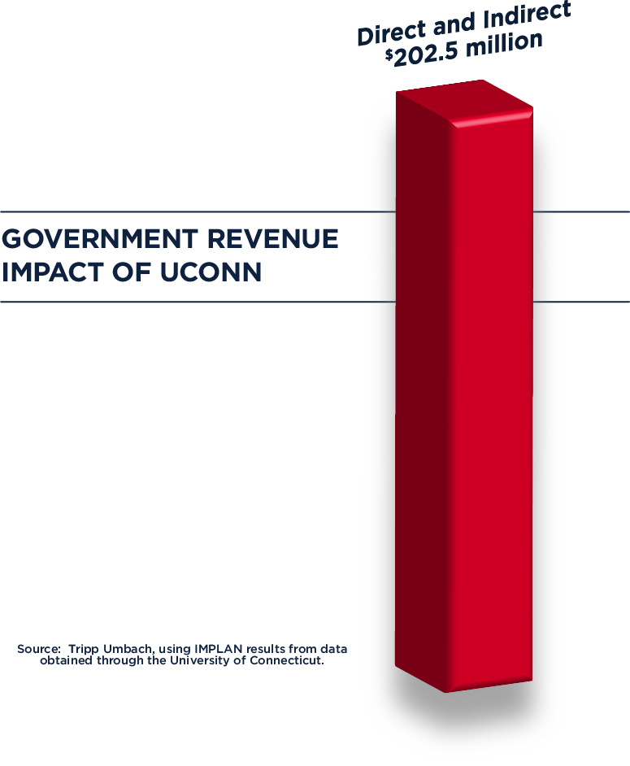
Growing the state and local tax base
Often there is a misperception that public universities do not generate tax revenue.
State and local government revenues attributable to the presence of UConn totaled $202.5 million in
FY 2012–13.
Through its local spending, as well
as direct and indirect support of jobs, the presence of UConn stabilizes and strengthens the local and statewide tax base.
9

Slide 10
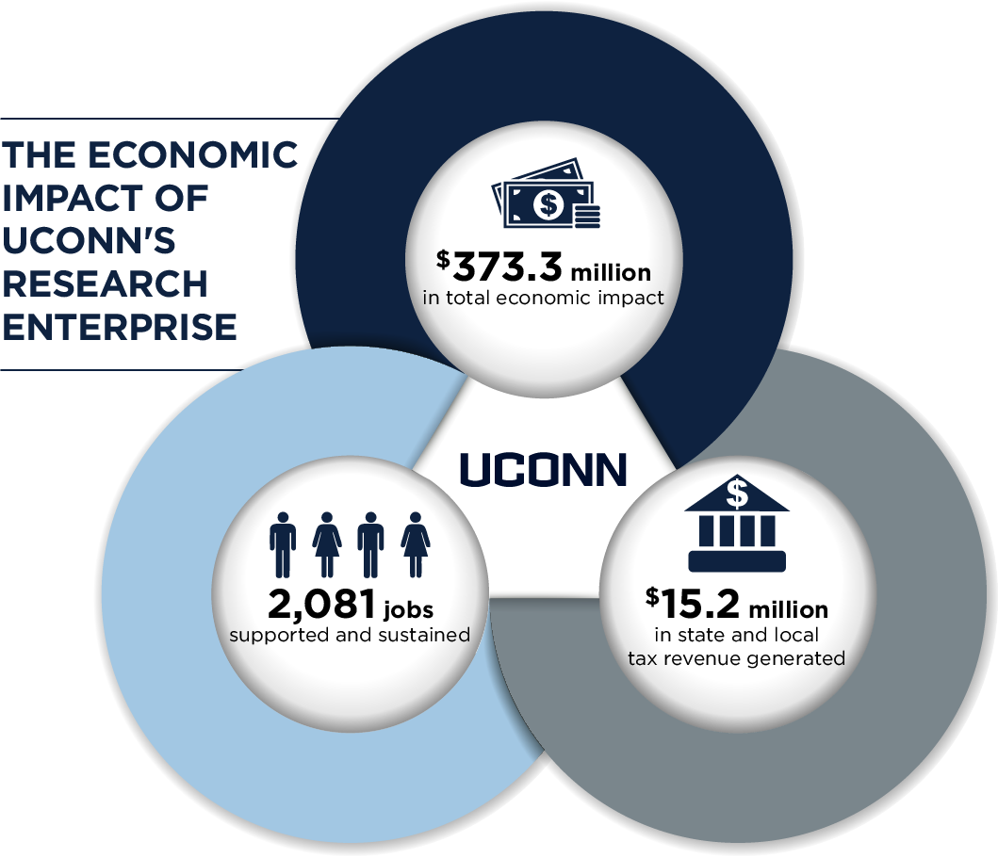
Research brings in fresh dollars
10
Notes:
In 2012, John Dempsey Hospital provided more than $6.1 million in care to Connecticut residents for which it did not receive full compensation (charity care or bad debt).
The UConn School of Medicine provides $1.1 million in charity care and more than $4.4 million in non-reimbursed dental care annually.
In 2013, UConn faculty, staff, and students donated $12.4 million to local charitable organizations.
UConn faculty, staff, and students provide a generous amount of hours in volunteer services. The economic value of such services is estimated at more than $49.9 million.

Slide 11
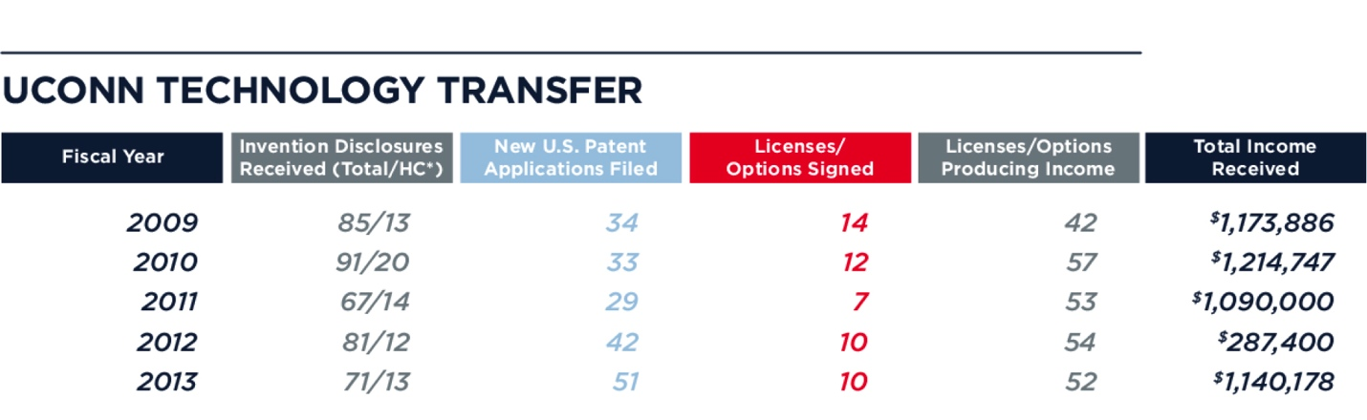
Transforming research into action
UConn has made significant strides to harness the potential of research commercialization and tech transfer.
Source: University of Connecticut
*HC is an abbreviation for UConn Health
11

Slide 12
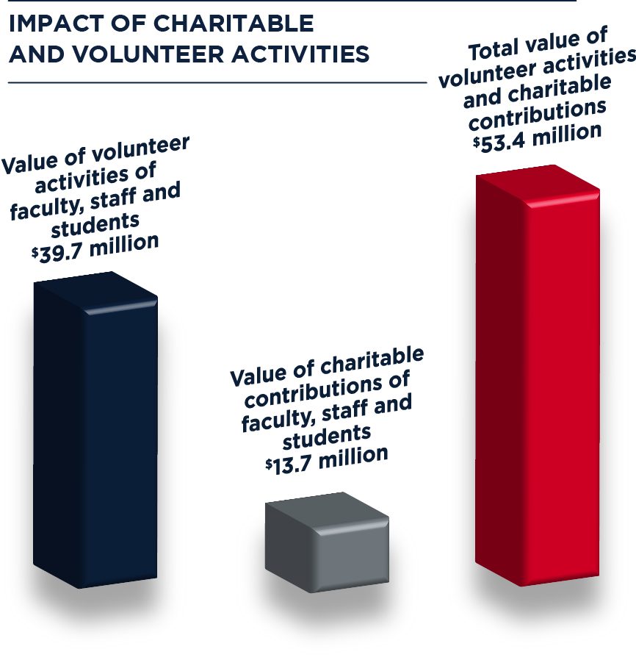
Making a difference in the community
Tripp Umbach estimates that UConn staff, faculty, physicians, and students generate more than $53.4 million annually in charitable donations and volunteer services.
12
Notes:
In 2012, John Dempsey Hospital provided more than $6.1 million in care to Connecticut residents for which it did not receive full compensation (charity care or bad debt).
The UConn School of Medicine provides $1.1 million in charity care and more than $4.4 million in non-reimbursed dental care annually.
In 2013, UConn faculty, staff, and students donated $12.4 million to local charitable organizations.
UConn faculty, staff, and students provide a generous amount of hours in volunteer services. The economic value of such services is estimated at more than $49.9 million.

Slide 13
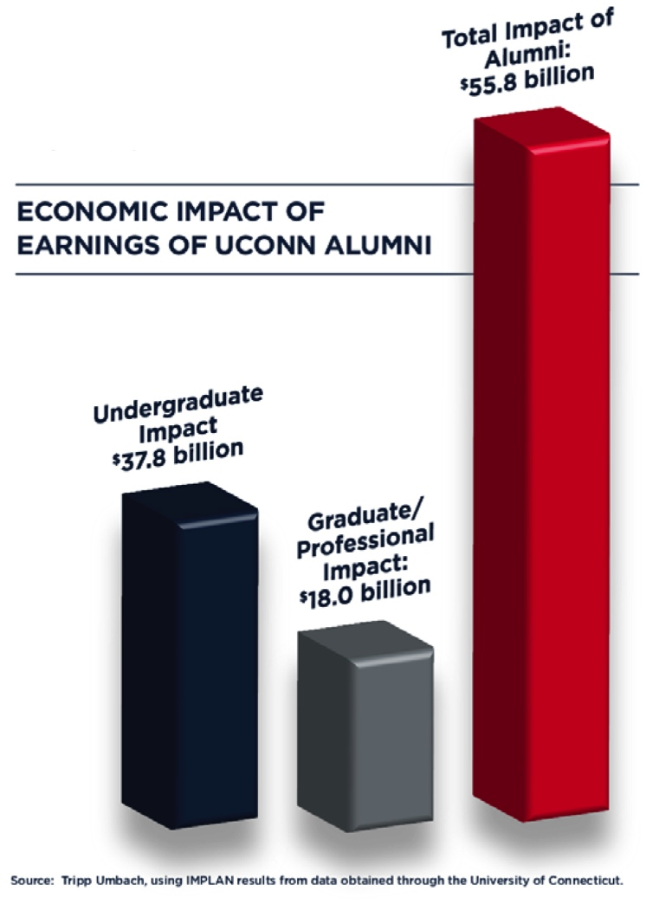
Generating impact after graduation
Tripp Umbach estimates that the 123,000 alumni who have graduated in the past 30 years and are living in the state of Connecticut, support $55.8 billion in additional income in the state’s economy.
13

Slide 14
Why is this important?
$3.4 billion in economic impact to the state.
24,235 jobs for Connecticut citizens. One in 90 jobs in the state is sustained by UConn.
$202.5 million in tax revenue to the state and local governments, including sales, property, and business tax payments.
UConn staff, faculty, and students generate $53.4 million annually in charitable donations, volunteer services, and provision of care.
14

Slide 15
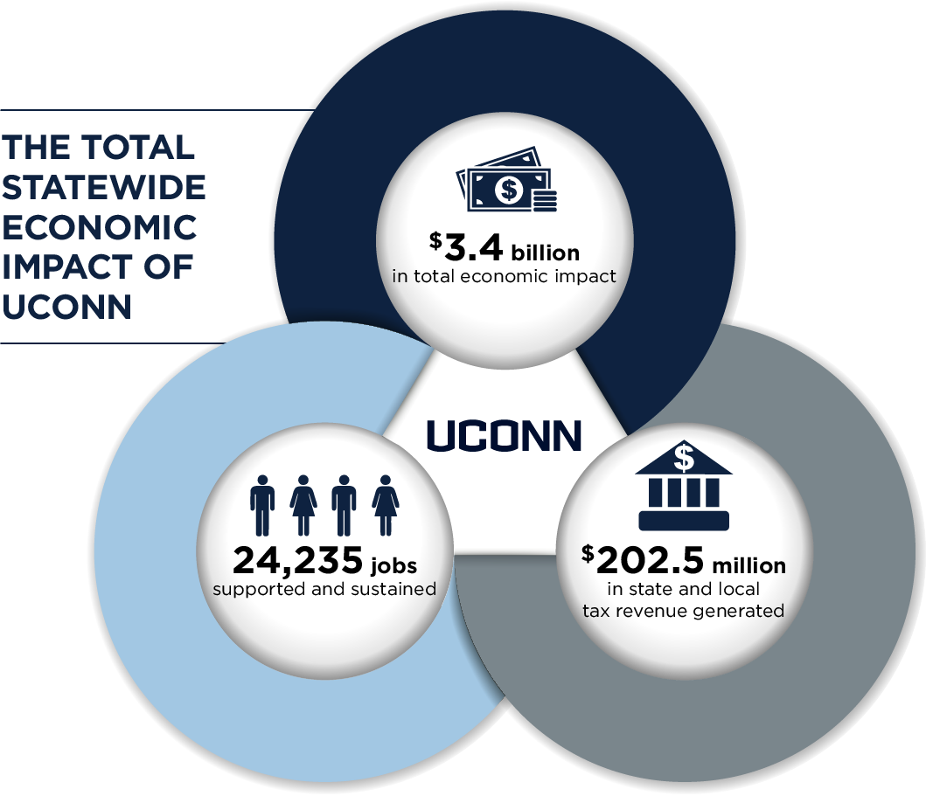
Questions & Answers
15

